Slide 1

Hack4Farming Hyderabad
May 12-13, 2016

Slide 2











Who is aWhere?
aWhere is an agriculture intelligence company
providing a complete ag-weather information services
and insight for real-time agricultural decisions
Notes:
aWhere is an agriculture intelligence company
with the most complete ag-weather information service
and insight for real-time agricultural decisions, globally

Slide 3
Solely Focused on
Agriculture
We are exclusively focused on agriculture outcomes. This defines our company and technology so we can uniquely understand how to create agricultural insight.
Complete Global
Information & Insight
We integrate a wide variety of data and processes to create complete and accurate ag-weather and agronomic insight both globally and at the field level.
Rapid, Flexible Delivery
Our flexible and easy-to-integrate platform enables our customers to access our information and insight how, where and when they want it.
Notes:
WHY AWHERE
First = weather data and agricultural intelligence company in the market that focused only on agriculture. Others started elsewhere and are adapting their products to the market without the institutional experience or insight.
Only = wide variety of data sources and advanced processing
Best = technology

Slide 4
aWhere Delivers Information & Insight
aWhere
CSU
Precipitation
(university)
GWC
Forecast
Current Cond.
Alerts
(private)
AWIS
Observed Weather
(private)
Raw
Data
Raw
Data
Agriculture
Information
Leverage
Derive
Agricultural
Insight
NASA
TRMM3B
Precipitation
(gov’t)
Processes
Expertise
Aeris
Weather Maps
Current Cond.
Forecast
(private)
NCEP
Forecast
(gov’t)
NOAA
Doppler Radar
Precipitation
(gov’t)
Sell
Sell
APIs
Customers
Apps

Slide 5
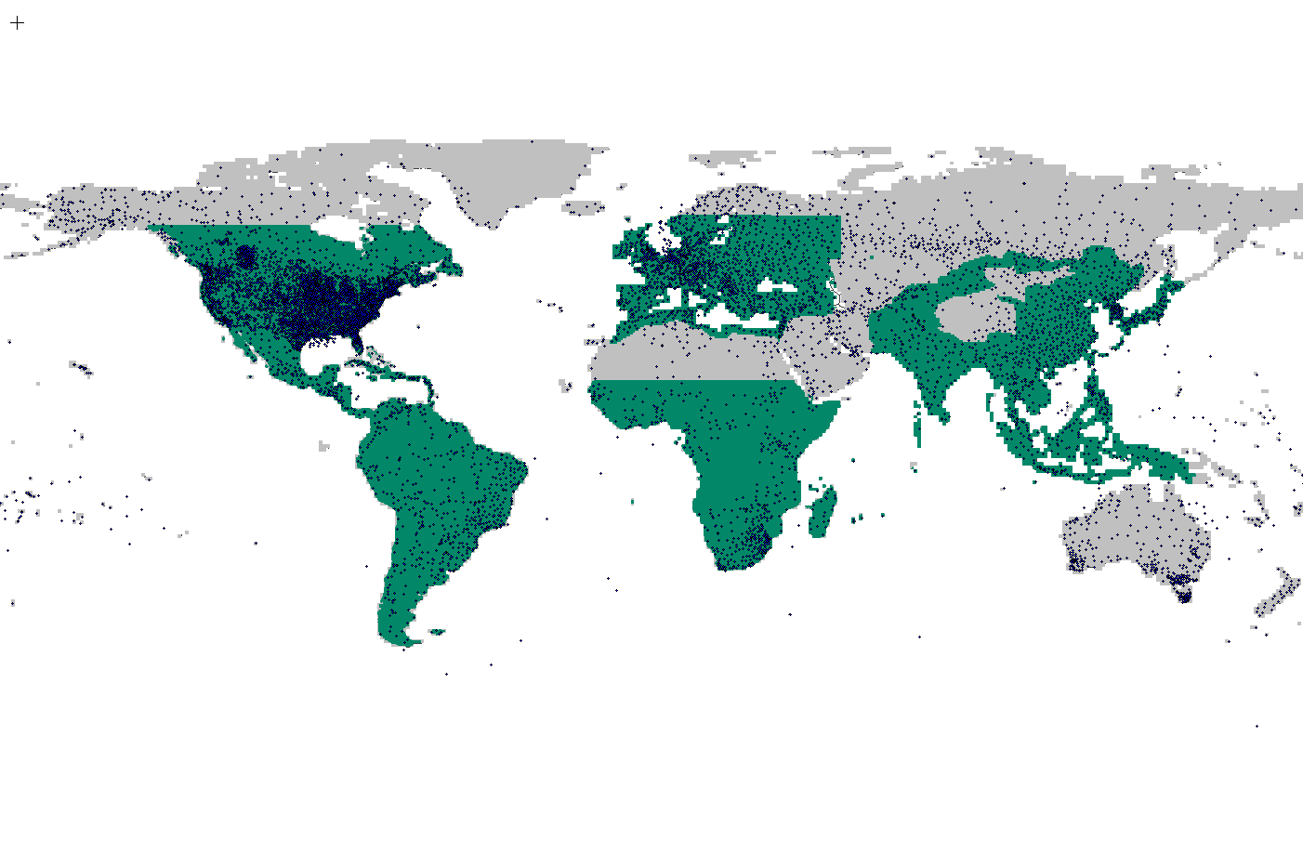
Complete Global Information and Insight…
aWhere completely covers the
Agricultural Earth with 1.46M Data Points
Many agriculture users rely on weather stations only

Slide 6
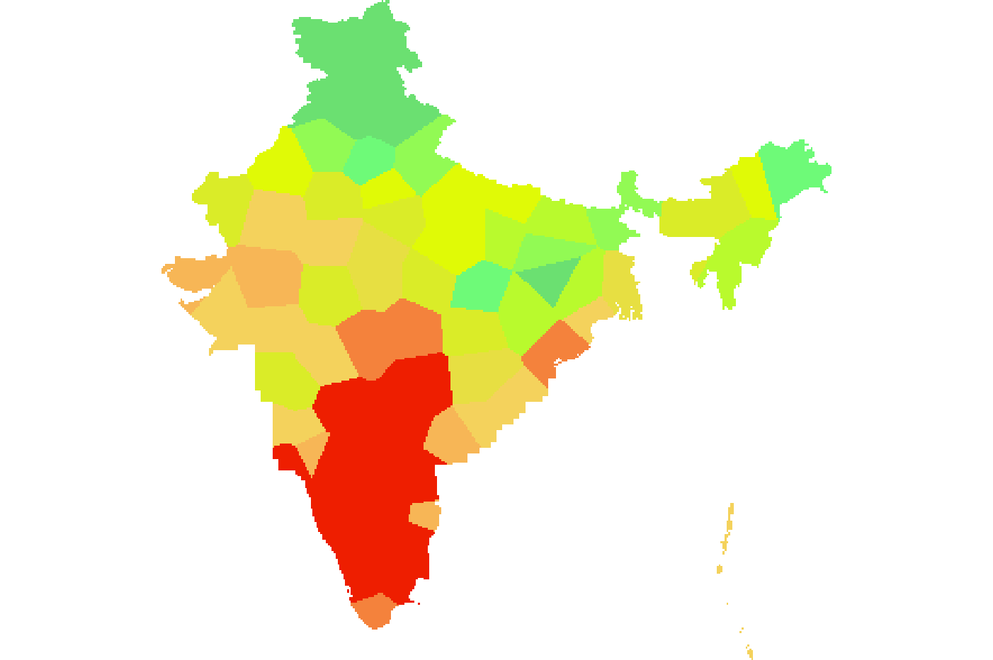
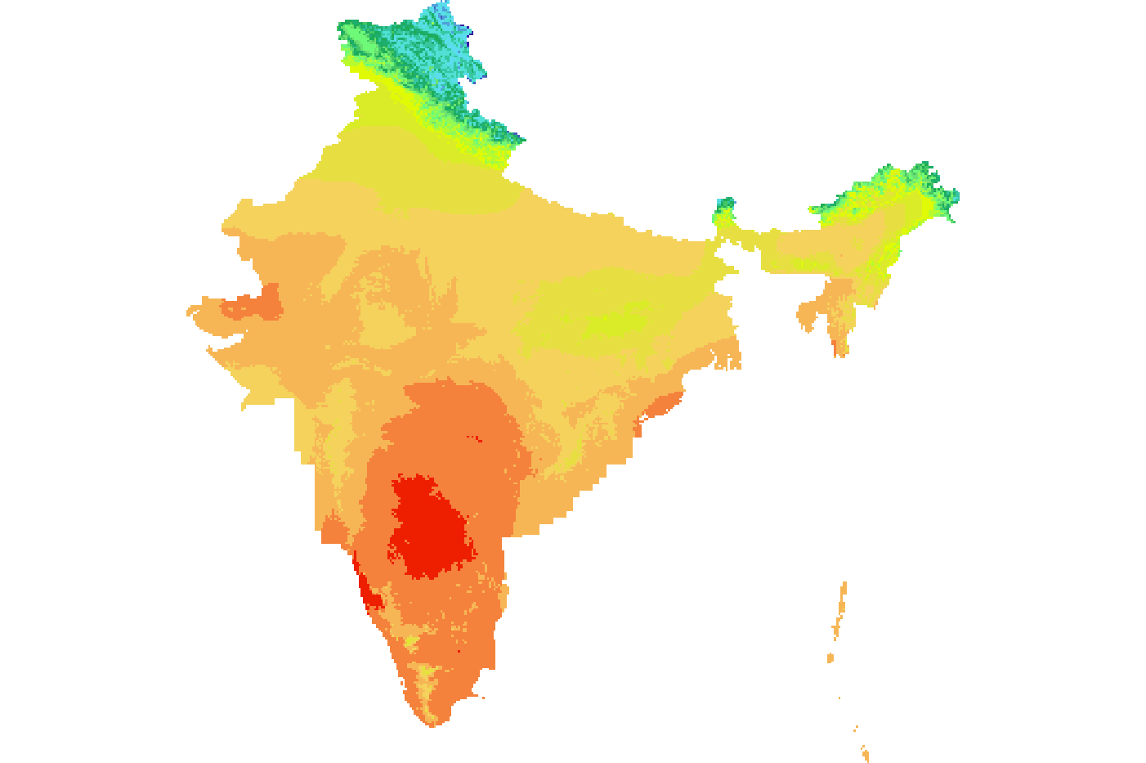
More Specific Data = Better Information…
Relying on inferior data results in incorrect decisions
More specific information gives more clarity
India
Free and Paid Providers
78 Data Points
Approx. Every 120km
India
aWhere
41,000 Data Points
Every 9km

Slide 7
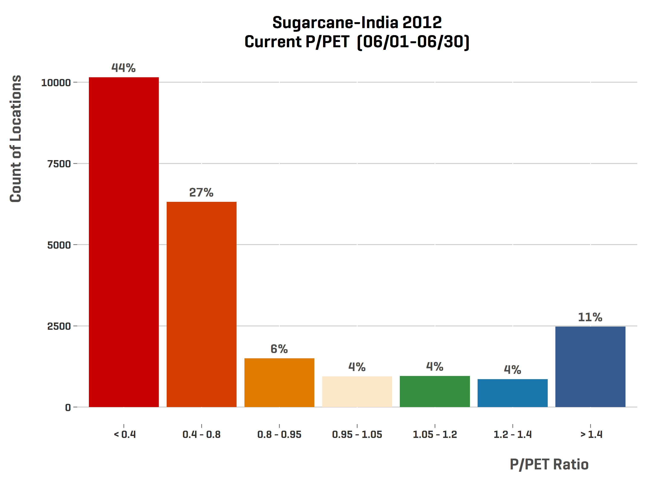
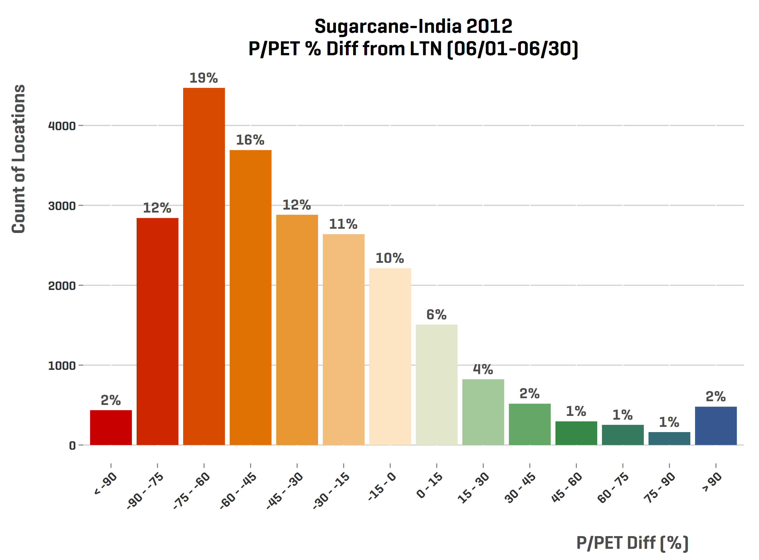
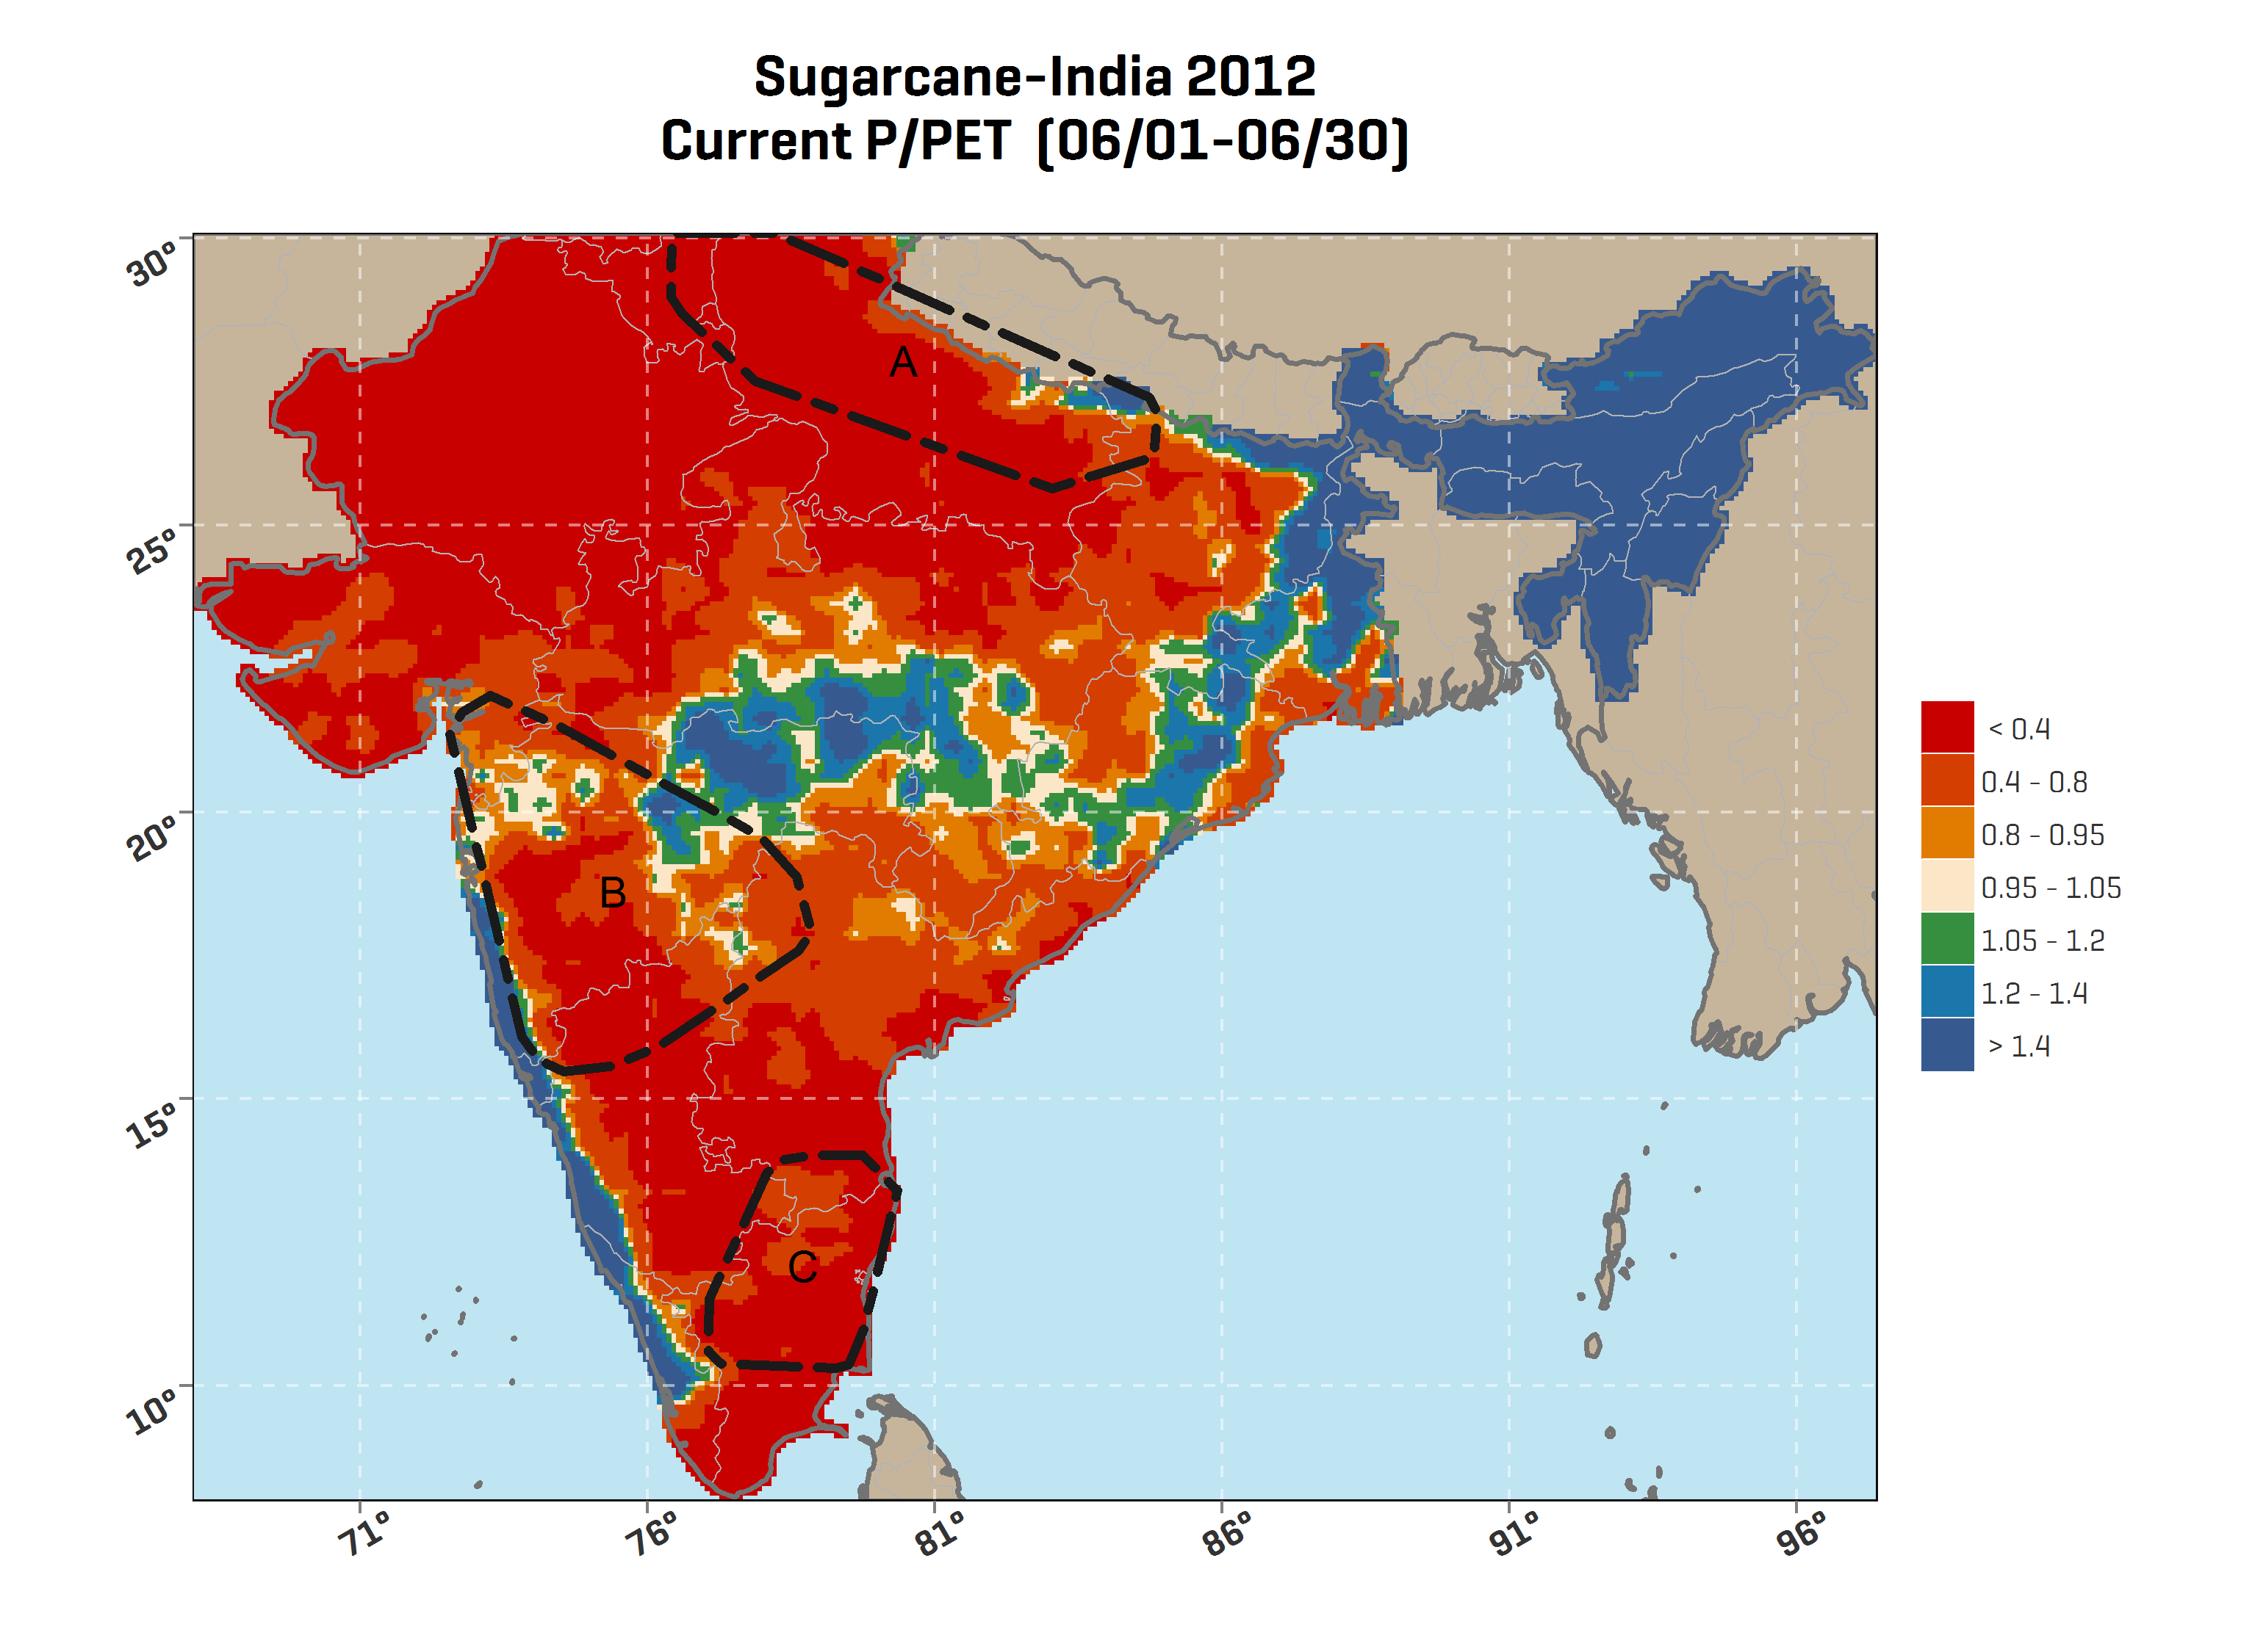
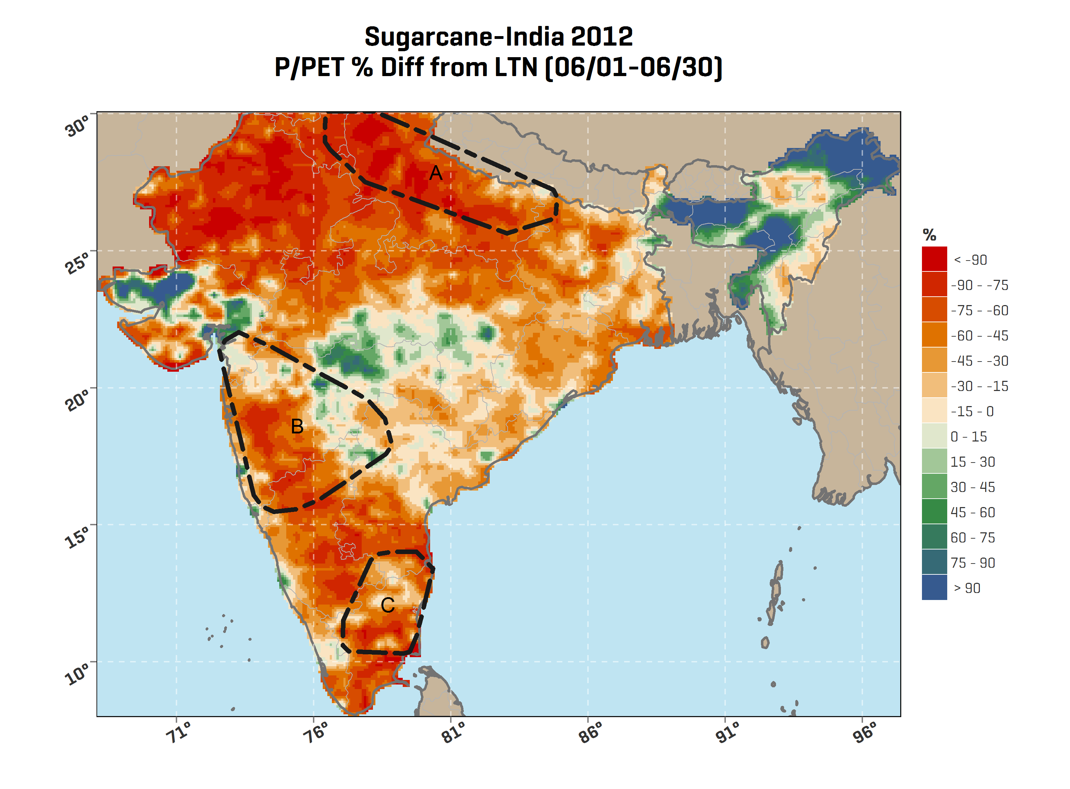
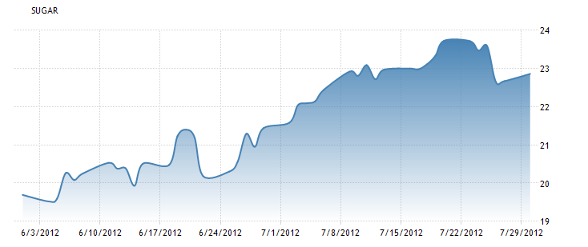
Better Information enables Predictive Insight…
In June 2012, India experienced a very low Precipitation-to-PET ratio, indicating severe crop stress in major sugar regions. This was seen later in the global supply chain and the price of sugar jumped.
Analysis period

Slide 8
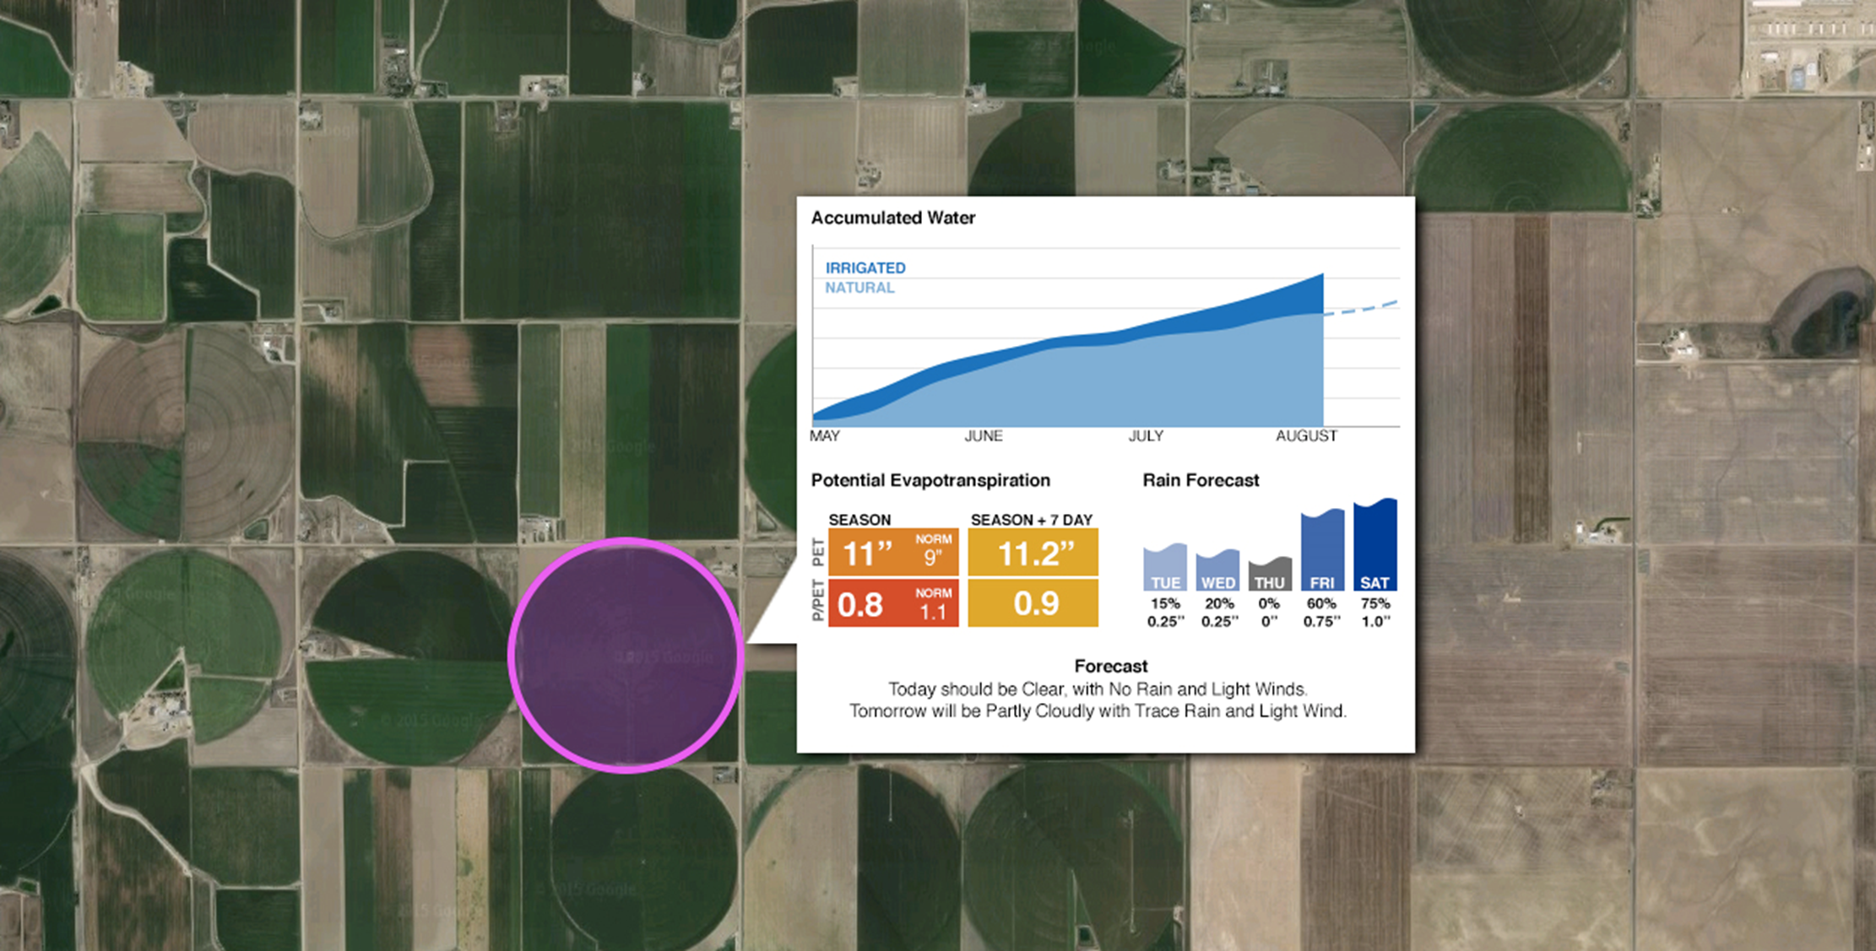



Better Information enables Field Insight
When to irrigate?
How much to irrigate?
When to plant?
What pests to scout for?
When and what to spray?
When and how much to fertilize?
When will harvest be?
How much yield is expected?

Slide 9
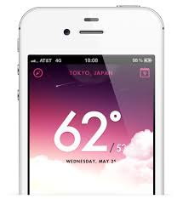


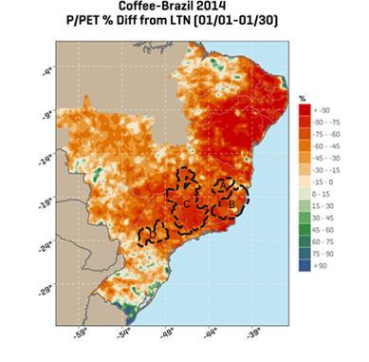
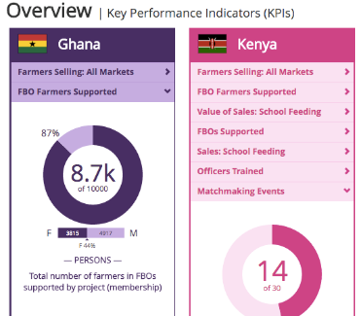
Rapid, Flexible Delivery
Direct Integration
by API
Farmer Apps
SMS Delivery
R&D
Commodity Models
Agriculture
Information
aWhere’s
Platform
unlocks
Information
And
Insight
Interpreted Insight
Commodity
Intelligence Reports
and Indices
Agricultural
Insight
Professional
Services
Customized
Implementations
and Analysis

Slide 10
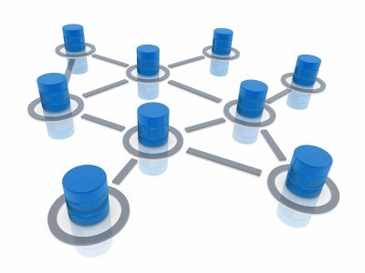
What is an API?
Application Programming Interface (API)
A set of functions and procedures that allow the creation of applications which access the features or data of an operating system, application, or other service.

Slide 11
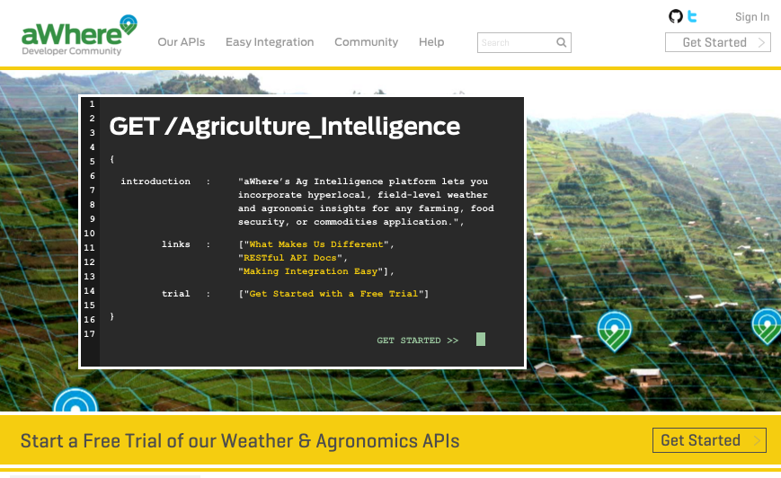
The aWhere Developer Community provides everything needed to get started & stay moving with the API Platform.
Comprehensive Documentation
Tutorials & Best Practices
Sample Code
Postman & Swagger Definitions
Support Community
Self-Service API Keys
Coming in Q4 2016: Access to metrics
Get started with a trial at
developer.awhere.com

Slide 12
API Solution Examples

Slide 13
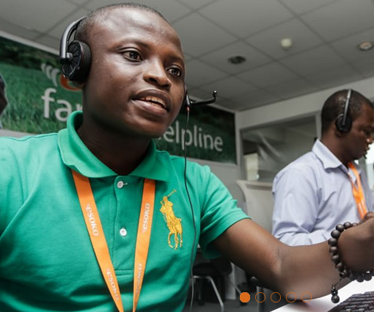
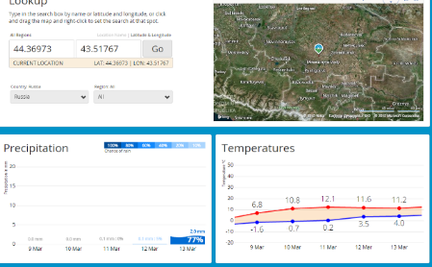
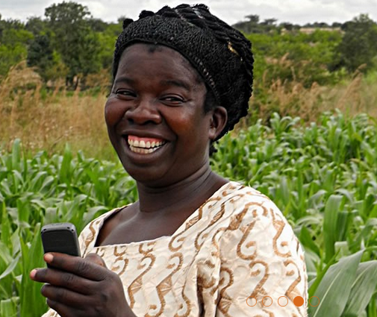
ICT for Agriculture
Personalized weather forecast and agronomic tips to farmers
Supported with Call Center Apps
Farmers are equipped to make better growing decisions
Technology: aWhere API, PHP, SMS, USSD, Voice and Mobile Apps

Slide 14
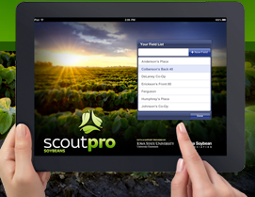
Scouting Application
Pest and disease observations
Prediction of where and what to look for
Prediction of pest and disease risk levels
Forecasts
Technology: aWhere API, iPad iOS

Slide 15
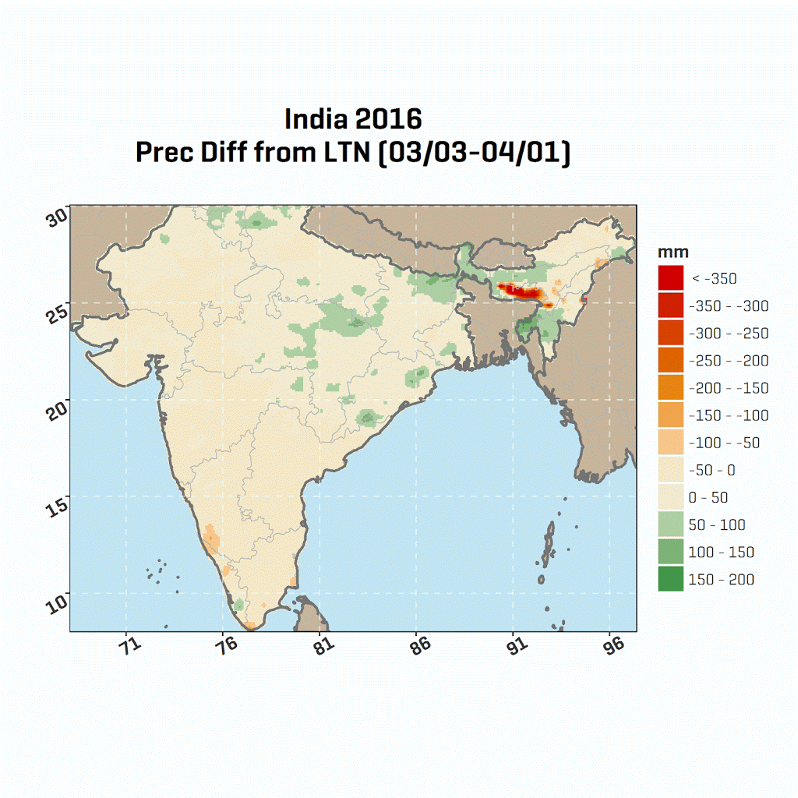
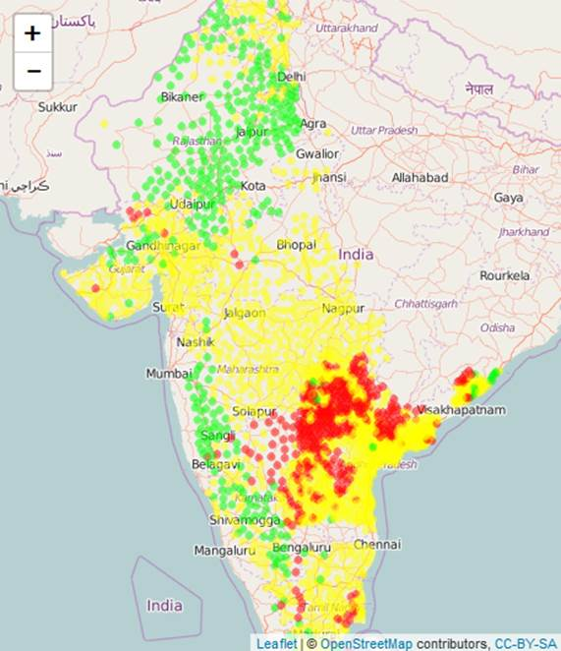

Predictive Analytics
Monitoring weather based stress e.g. precipitation to normal
Prediction of crop production based on past yield correlations
Assess specific crop growing areas
Technology: aWhere API, R Studio, HP Vertica

Slide 16
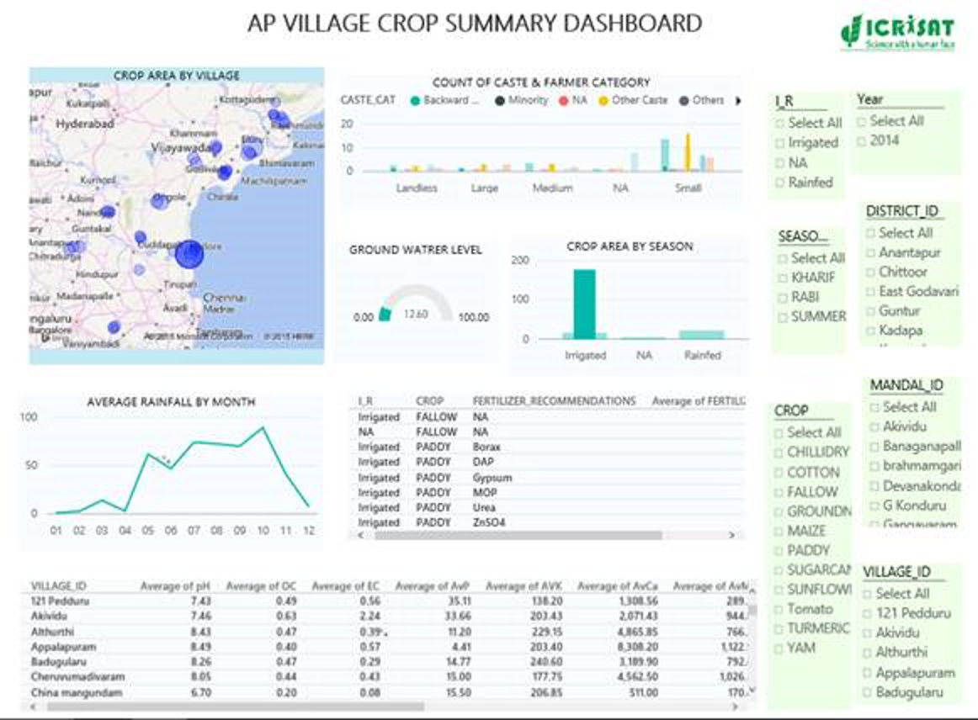
Country and Regional Monitoring
Integrate into dashboards
Village level data
Seasonal progress
Weather forecasts
Spatial distribution of weather and crop stress
Technology: aWhere API, Azure

Slide 17
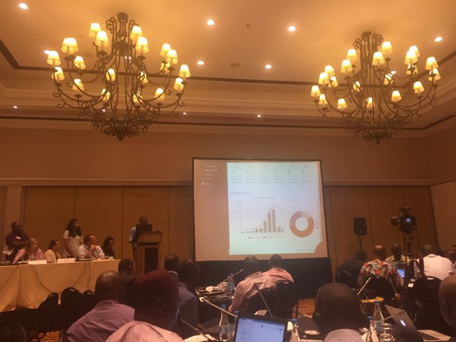
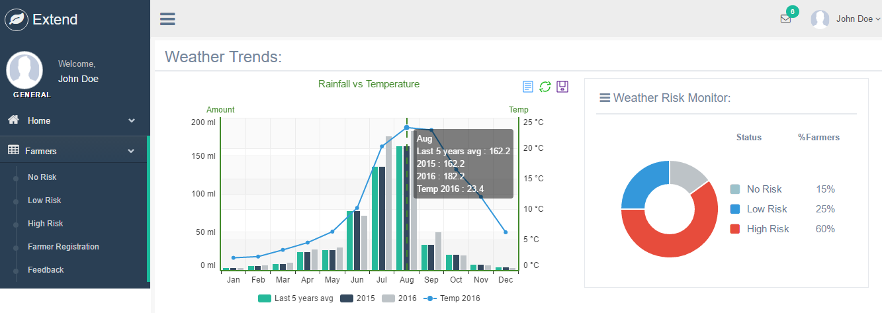
Hackathon – Extension Dashboard
Track extension area farmers
Analyze crop stress and prioritize visits
Technology: aWhereAPI, PHP
EXTEND
UNDP ActionHack
Zambia, March 2016

Slide 18
What is a Hackathon?

Slide 19
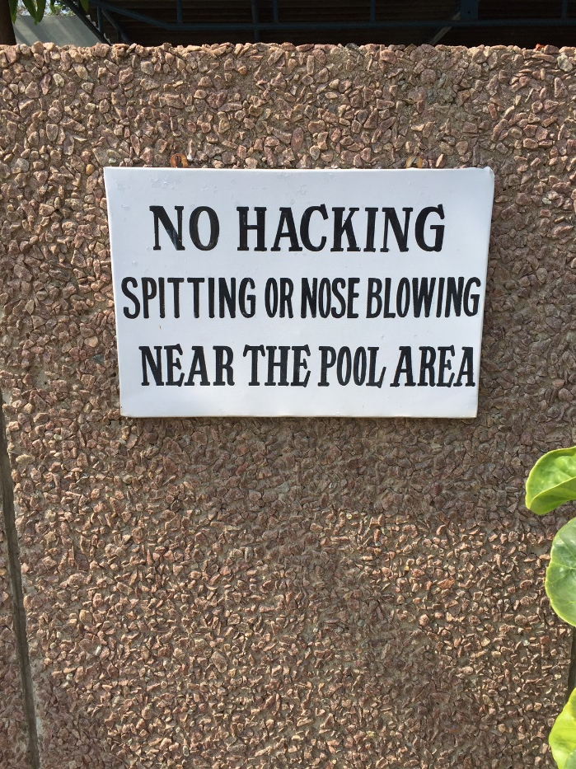

Slide 20

A hackathon is an event in which computer programmers and others involved in software and hardware development collaborate intensively on software projects

Slide 21
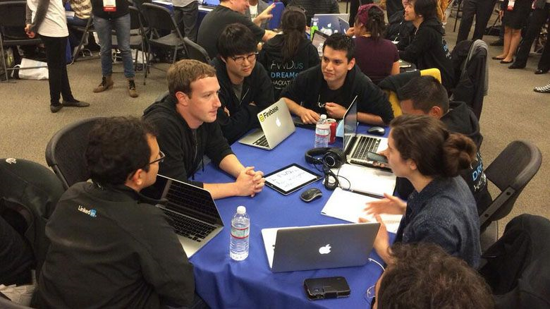
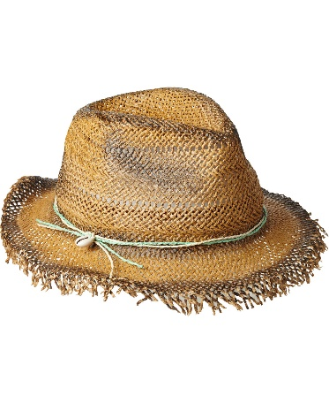

Notes:
Computer Clubs (HomeBrew, Apple - 1970’s)
“Hackathon” was coined in 1999 by Sun and OpenBSD

Slide 22
Why a Hackathon?

Slide 23
Hackathon ROI
For ICRISAT it helps generate new ideas on how to close the knowledge gap between science and farmers
For T-Hub it supports their mission of entrepreneurial incubation
For aWhere and Microsoft it creates new partnerships and businesses that can grow into customers
For developers there are prizes!!
All participants are embedded in a create fun and productive environment
For farmers there are new application ideas that can help improve productivity and profitability

Slide 24
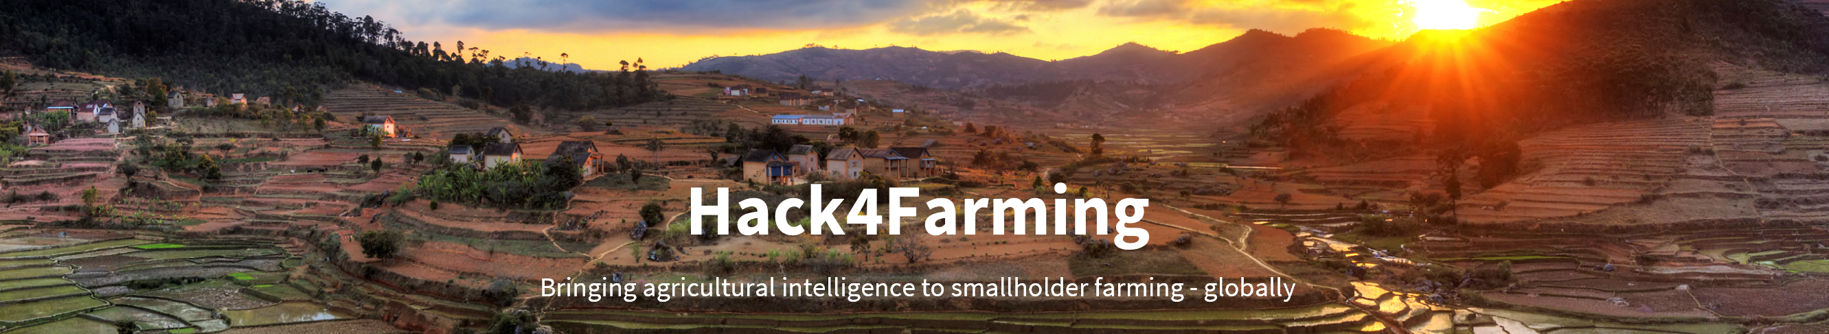
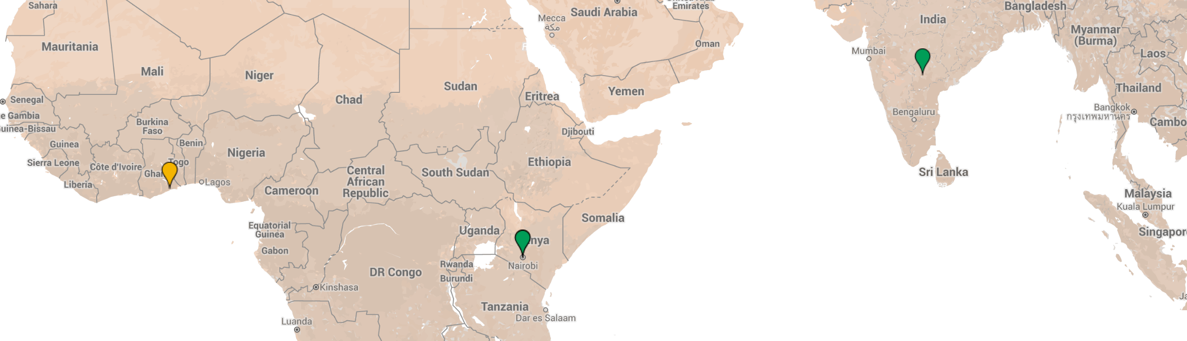
Hack4Farming Series

Slide 25
The Hack4Farming Hyderabad Challenge
Using your team’s expert knowledge and the tools/datasets made available to you, design a solution that can address an informational gap in Indian agriculture.
This solution should identify the information gap, provide a prototype or proof of concept for the solution, and address the sustainability of the solution through a business plan, proposal outline, or other mechanism.

Slide 26
Judging Criteria
Impact – Is there a clear causal link established between the application/idea and improvement of information available to Indian farmers and agriculture decision-makers?
Innovation – Is the solution novel? Does it solve a problem in a new or creative way?
Technical Achievement – Does the submission solve a difficult technical problem?
Sustainability – Is there a well articulated business model for how the solution will be distributed, adopted and maintained? Why would someone invest in this idea?

Slide 27
Solution Design Considerations
Who are your users?
What is their problem?
What is your solution?
What is the market and potential impact?
What data do you need to solve the problem?
What technology do you need?
How will you maintain and deploy the solution?
What is the business model and sustainability plan?

Slide 28
Awards
A shared cash prize of $2,000 (US equivalent) to be split among eligible team members
Mentoring from T-Hub to help incubate a company/product idea, including the following:
Business-specific mentoring, which covers topics like speed to scale, Lean canvas / Business plan, Pitching, PR & Marketing, Basic working law for startups, Basic corporate law, and engagement with TG
Sector-specific mentoring, in partnership with ICRISAT on agriculture R&D
Access to listed T-Hub service providers who provide a range of services pertinent to early stage startups.

Slide 29
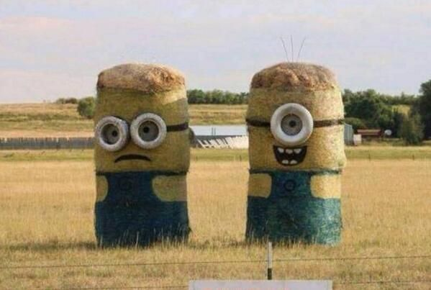
Be Creative!
Have Fun!

Slide 30


Slide 31
Social Media
Twitter:
Follow and tweet the hashtag #hack4farming on Twitter
Follow @MicrosoftIndia, @ICRISAT, @THubHyd, @aWhere
Facebook
https://www.facebook.com/Microsoft.India.Development.Center
https://www.facebook.com/ICRISAT/

Slide 32
aWhere Resources
https://developer.awhere.com
/hack4farming (Resources Page)
/api/reference (API documentation)
/integration/code (Sample code)
https://github.com/aWhereAPI
Additional code repository

Slide 33
Logistics
Each team assigned to a room – check the signs!
Internet logins posted on the wall
Each team has access to Microsoft Azure account
Self signup for aWhere API
Hackathon Rules and the Challenge
Ask for help:
Hanna, Leila, Stewart, Nalini, Ragini

Slide 34
Event Program
May 12, 2016
11:15 am – 8:00 pm (Building 212) | Stage 1: Team brainstorming aWhere API platform and Microsoft Azure info sessions [aWhere, Microsoft, ICRISAT partners] (if desired) Initial coding and prototyping Lunch hour: 12:30 pm - 1:30 pm (204 – Banquet Hall) Tea break: 3:00 pm – 3:30 pm (212 Foyer) Dinner hour (optional): 7:00 pm – 8:00 pm (IMOD Plaza)

Slide 35
Event Program
May 13
8:30 am – 2:00 pm (Building 212) | Stage 2: Coding/Prototyping Pitch/Presentation Drafting Tea break: 10:30 am – 11:00 am (212 Foyer) Lunch Hour: 12:30 pm - 1:30 pm (204 – Banquet Hall)
2:00 – 3:00 pm (Building 212) | Stage 3: Final edits to team project presentations Partners available for presentation feedback & set-up Tea break: 2:30 pm – 3:00 pm (212 Foyer)
3:00 – 5:00 pm | Presentations of projects to judges Awards presentation Post-announcement networking and conversation

Slide 36
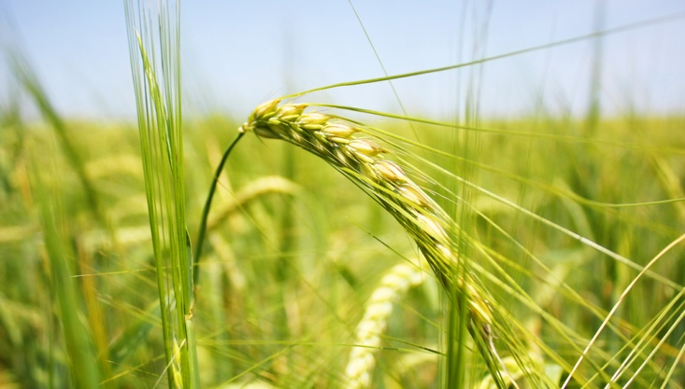

Denver, CO
awhere.com
303-279-9293
Stewart Collis
stewartcollis@awhere.com
@stewartcollis
©2016 aWhere, Inc. Customer logos copyrighted by their respective owners. Some images licensed under Creative Commons courtesy NOAA, Ladd Observatory, Stephen Bowler

